Slide 1
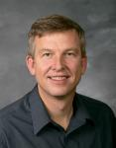
CS 224 – Computer Systems
Spring 2015
Section 001, 1:00 – 3:45 pm T,Th (111 TMCB)
Instructor:
Mark Clement
Office: TMCB 3332, 422-76089
Office Hours: 4-50 pm T,W,Th
Email: clement@cs.byu.edu

Slide 2
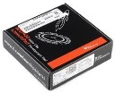
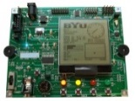
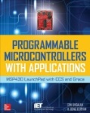

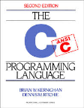
Course Information
Syllabus
Class website (http://students.cs.byu.edu/~clement/cs224)
Syllabus / Schedule / Info
Labs / Homework
Slides / Reading assignments / Reference material
Web submission / Help queue
Required Class Materials
LaunchPad Development Tool (~$10) Available from Texas Instruments on-line (www.ti.com) ORDER NOW!
RBX430-1 Development Board ($80) Available in Computer Science Office – 3361 TMCB (Need Student Signature Card)
Programmable Microcontrollers with Applications: MSP430 LaunchPad with CCS and Grace by Cem Unsalan and H. Deniz Gurhan. Available in BYU Bookstore or online from a book dealer like Amazon.com (~$50)
Code: The Hidden Language of Computer Hardware and Software by Charles Petzold.
Recommended Class Materials
C Programming Language (2nd Edition, Prentice Hall) by Brian W. Kernighan and Dennis M. Ritchie

Slide 3
Grading
Syllabus
Lab assignments (55%)
Lab 1: Data Types (3%)
Lab 2: Blinky (4%)
Lab 3: Microarchitecture (6%)
Lab 4: Traffic Light (5%)
Lab 5: Morse Code I (6%)
Lab 6: Morse Code II (6%)
Lab 7: Life (8%)
Lab 8: Threads (8%)
Lab 9: Process Control (9%)
Homework (15%)
Quizzes (5%)
Midterm (10%)
Final Exam (15%)
A = 93% C = 73%
A- = 90% C- = 70%
B+ = 87% D+ = 67%
B = 83% D = 63%
B- = 80% D- = 60%
C+ = 77% E = below 60%

Slide 4
Labs (55%)
Syllabus
Each student is to complete his own labs.
All submitted lab source code must contain header comments that include student’s name and a declaration that the completed assignment is their own work (accept for group labs) in order to be accepted.
Lab assignments must be completed and passed off with a “Date Modified” timestamp on or before the due date to receive full credit.
NOTE: Timestamps cannot be used for bonus credit points.
Any lab assignment submitted after the due date will lose 10% per school day (up to a maximum of 50%).
All completed labs will receive a minimum 50% credit - no lab less than 50% completed will be accepted.
Labs passed off at least one day before the due date (no timestamps) receive an additional 10% bonus credit. (Labs completed in previous semesters DO NOT qualify for early pass-off bonus credit.)
Bonus credit on any lab is only awarded after all regular requirements have been completed (including bonus labs).

Slide 5
Homework (15%)
Syllabus
Homework is due in class on the last lecture day of each section.
Most homework consists of 5 to 10 questions and covers the material from the previous 2-4 class discussions, but may cover additional material not discussed directly in class.
Homework must have your name and section (clearly legible) at the top of the homework and to be accepted for grading.
Homework will be graded by each student in class, submitted at the end of class for recording of the score, and returned the following class period. (Subject to available time.)
NO LATE HOMEWORK WILL BE ACCEPTED.
You are welcome and encouraged to discuss the homework with your classmates and others outside of class. However, you are to do and submit your own work. Submitting someone else’s work is considered cheating for which you will receive an E grade for the class and be reported to the Honor Code Office.

Slide 6
In-class Quizzes (5%)
Syllabus
In-class quizzes are to encourage class attendance and participation.
The quizzes are formulated from class lecture and emphasize application of specific learning objectives.
In-class quizzes will be handed out and collected in class.
No late quizzes will be accepted.
Quizzes will be graded on a pass/fail basis.

Slide 7
Miscellaneous
Syllabus
All exams are administered in the Testing Center.
To receive an A or A- grade for the class, a student must complete all required labs and pass the final exam (70% or better).
Anyone who completes all the required labs and passes the final exam (non-normalized 70% or higher), will receive no lower than a C-.
Any grade points earned on labs above the allotted lab percentage will apply towards your overall grade.
It is the student’s responsibility to present their lab work to a TA on a personal computer or in a Tallmadge Computer Science computer lab for pass off during regular TA hours.
BYU Grades will be used to record scores (and approximate grade).
Laptops will be used during class to work on labs, so bring one.
Questions…

Slide 8
And Finally...
Syllabus
If you find yourself struggling with the material, falling behind on assignments, facing personal problems, lacking motivation, or any experiencing any difficulty that effects your school work…
Resolving problems sooner is always better than later.
Talk with the professor at the first sign of problems.
Attend all lectures and help sessions.
Work with the TAs – especially in morning hours.
Maximize deadlines met.
Run to completion – avoid context switching (distractions).
There is little that can be done to improve your grade if you wait until reading day.

Slide 9
Computers – Magic Boxes?
What’s inside
this thing???

Slide 10
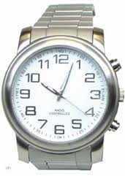
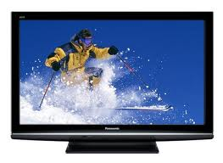
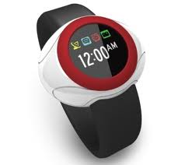
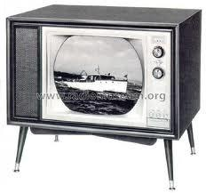
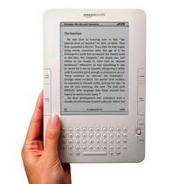
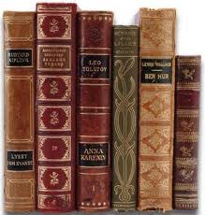
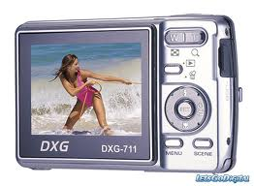
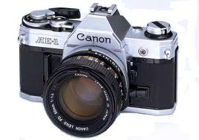
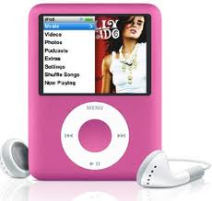

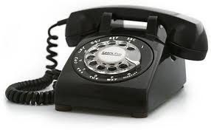
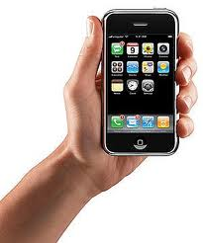
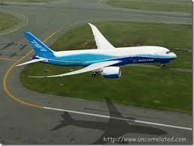

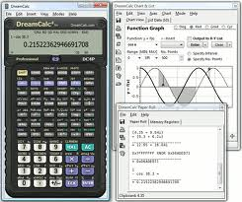

Analog to Digital Transformation
Computers
→ LCDs
Wristwatches
Books
Film
LP’s
Rotary phone
NTSC
Slide rule
737’s
→ Nooks
→ Flash
→ MP3
→ Smart phone
→ HDTV
→ Calculator
→ 787’s
Notes:
Analog: Caller leaves a voice mail
Digital: Google synthesizes and translates the analog signal to text
Analog: I read or listen to the voice mail
Real life is analog, not Digital.
We all love digital. It makes our lives easier and faster. But I’m not sure we all have an appropriate understanding of what digital and analog really mean. The fact of the matter is that we don’t live in a digital world. Our world is purely analog. We just have digital processes that happen in some mysterious box in technology-land.

Slide 11
No Magic to Computing…
Computers
A computer
does not have a mind of its own.
follows instructions exactly and repeatedly.
is built from many fast, simple parts.
A computer
has a set of instructions – program.
knows how to execute instructions – control.
executes instructions on data – data path.
Computers are ubiquitous (meaning everywhere!)
In theory, any computer can compute anything that’s possible to compute given enough memory and time.
In practice, solving a problem is constrained by speed, cost, and power – the difference is in scale not substance.

Slide 12
Price/Performance Pyramid
Computers
Clock Speed
Cost
Power
Differences in scale,
not in substance

Slide 13
The World of Abstraction
Abstraction
We abstract naturally–
Avoid getting bogged down in unnecessary details by focusing on the essential aspects of an entity.
More efficient to think about something at the highest possible level of abstraction (when everything is working fine).
Without abstraction, one would certainly be overwhelmed by the complexity of a computer.
But, when something doesn’t work, then abstraction fails and you have to look at the details.

Slide 14
Problem Solving w/Computers
Solving Problems
Wordprocessing…
Games…
Surfing the web…
Problem
Software Design:
choose algorithms and data structures
Algorithm
Programming:
use language to express design
Program
Compiling/Interpreting:
convert language to machine instructions
Instruction Set
Architecture
Instruction Set Design:
Design ISA that enables efficient problem solving
Micro-
architecture
Processor Design:
choose structures to implement ISA
Circuits
Logic/Circuit Design:
gates and low-level circuits to implement components
101011011…
Devices
Process Engineering & Fabrication:
develop and manufacture lowest-level components

Slide 15



Problems
Solving Problems
Why not use natural languages to program computers?
Incomplete
Missing words and/or word structures for computer procedures.
Imprecise
Words that mean the same thing are difficult to translate into computer instructions.
Ambiguous – the most unacceptable attribute!
To infer the meaning of a sentence, a
listener is often helped by the tone of the
speaker or the context of the sentence.
“Like me on Facebook.”
Recommend my product on Facebook.
Hey dude, I’m on Facebook!
Problems
Now playing on Facebook, “Like Me”.
Algorithms
Programs
Machine (ISA)
Microarchitecture
“Like Me”
Circuits
Devices

Slide 16
Algorithms
Solving Problems
An algorithm is a step-by-step procedure that:
guarantees to terminate (finiteness)
each step is precisely stated (definiteness)
each step can be carried out (effective computability)
Examples
Starting a car
Computing the average of n integers
How much money do I owe the IRS?
For any given problem, there are usually multiple algorithms that will work.
Problems
Algorithms
Programs
Machine (ISA)
Microarchitecture
Circuits
Devices

Slide 17
Programs
Solving Problems
An algorithm is tranformed into a computer program using a computer language.
communicate with the computer
defined by a grammar
mechanical rather than natural
not ambiguous
More than 1,000 programming languages
different languages for different purposes
financial processing/report generation
manipulating lists of symbolic data
natural language processing
often, just a personal preference
Problems
Algorithms
Programs
Machine (ISA)
Microarchitecture
Circuits
Devices

Slide 18
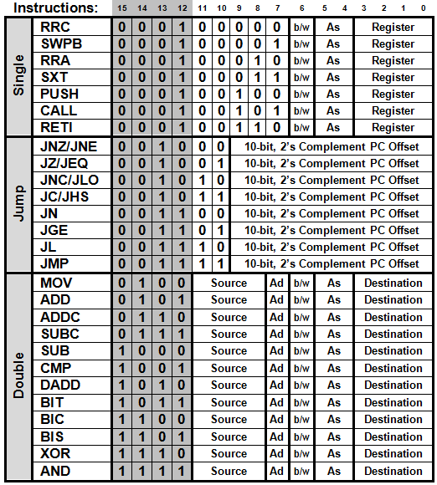
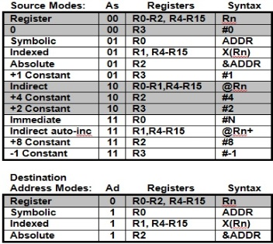
Instruction Set Architecture (ISA)
Solving Problems
The computer program (language) is translated into the instruction set of a particular computer
Specific to a CPU
Data types - what are the different representations of operands
Operations on data - what functions can be done
Addressable memory - where are operands stored
Addressing modes - how to find operands in memory
Problems
Algorithms
Programs
Machine (ISA)
Microarchitecture
Circuits
Devices

Slide 19
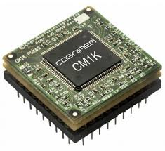
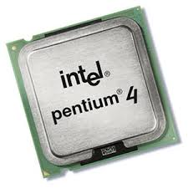
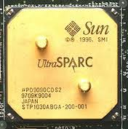
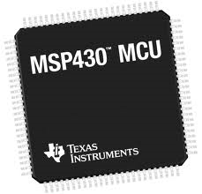
Microarchitecture
Solving Problems
The microarchitecture transforms the ISA into an implementation.
8051
IA-32
386
486
Pentium
Pentium-II, III, IV
Xeon
MSP430
How the operations in the ISA are implemented
how do you add two binary numbers?
or, how do you access memory?
faster and more complex
Problems
Algorithms
Programs
Machine (ISA)
Microarchitecture
Circuits
Devices

Slide 20
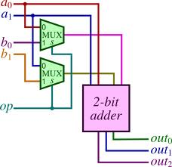
Circuits
Solving Problems
The next step is to implement each element of the microarchitecture with simple logic circuits.
Gates, adders, multiplexers
Flip flops, memory cells
Adders, subtracters, multipliers
Circuits are used to make the computer do useful things like multiply or store a result.
Problems
Algorithms
Programs
Machine (ISA)
Microarchitecture
Circuits
Devices

Slide 21
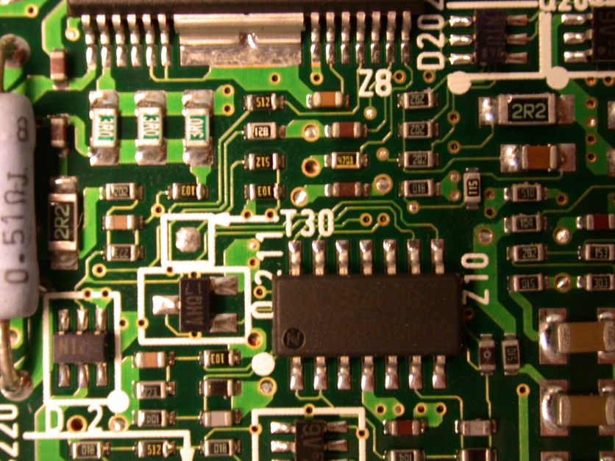
Devices
Solving Problems
Finally, each basic logic circuit is implemented by a particular device technology.
Wires and traces
Voltages
Types of circuits (transistors)
CMOS
NMOS
Gallium arsenide
Devices are the building blocks for more complex circuits.
Problems
Algorithms
Programs
Machine (ISA)
Microarchitecture
Circuits
Devices

Slide 22
Questions…
Define abstraction.
What is an algorithm?
What is the difference between a computer Instruction Set Architecture (ISA) and a computer micro-architecture?
At which level of transformation are solutions ambiguous?
Which level is concerned with voltages and electrons?

